Slide 1

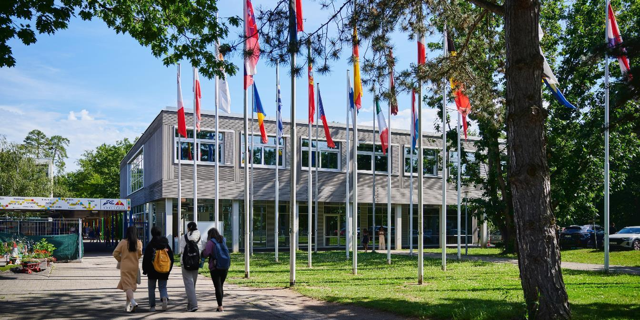
EUROPÄISCHE SCHULE KARLSRUHE
ECOLE EUROPEENNE DE KARLSRUHE
EUROPEAN SCHOOL KARLSRUHE

Slide 2
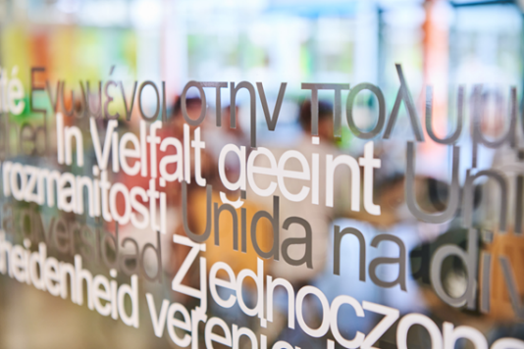
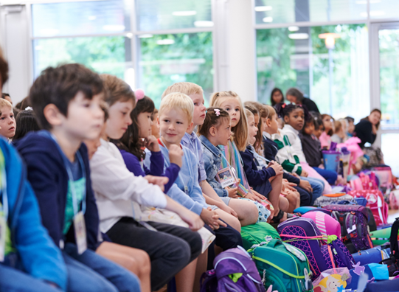
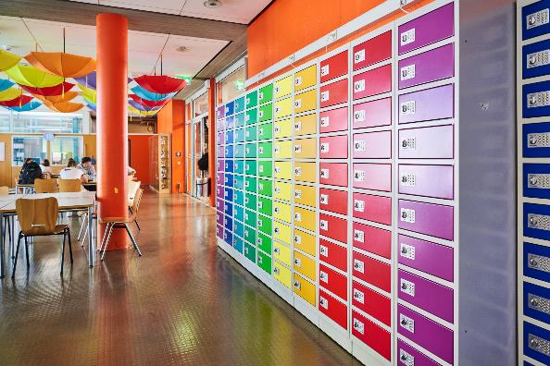
Organisation of the evening
(18:00-19:00)
Presentations of the School
  László MUNKÁCSY
  Holger KLOSE
  Anabela SANTOS
  Parents’ Association: Ms MARTENS, Ms THOMPSON-RENZ
  Stefania BARTHOLDY

Slide 3
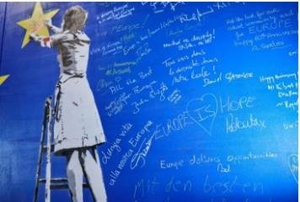
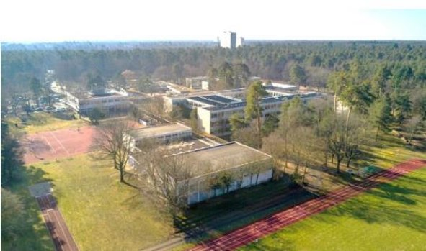
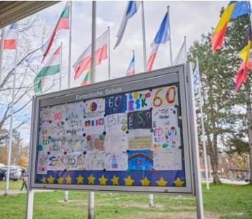
The European School System
The first school was established in 1953.
There are a total of 13 European Schools (ES)
(Brussels 1,2,3,4, Mol, Luxembourg 1&2, Alicante, Bergen, Frankfurt, Munich, Varese and Karlsruhe)
and 24 Accredited European Schools (AES).
European School Karlsruhe (ESK) : in Karlsruhe since 1962

Slide 4
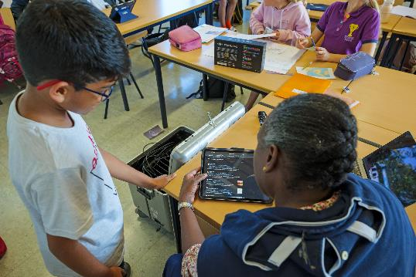
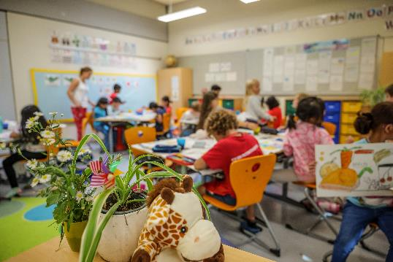
Key Features of the European Schools
Three language sections at the ESK (German, English and French)
From Nursery through Primary to Secondary
with the European Baccalaureate (BAC), internationally recognised and allowing worldwide opportunities to study
Multilingual education in all EU languages - as mother tongue, with qualified native speaker teachers
High-quality in teaching and learning, with special focus on well-being, teamwork, digital competences, creativity and critical thinking

Slide 5
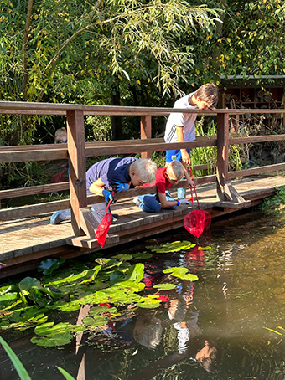
Nursery and Primary Cycle (ESK)
What is so SPECIAL about ESK?
A green 10ha campus -
attractive playground
Own garden and biotop
Fresh canteen meals
After-school care
ESK buses & Trams

Slide 6
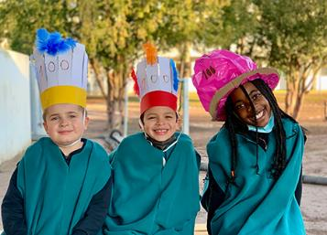
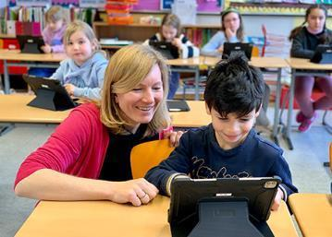
Nursery and Primary Cycle (ESK)
What is so SPECIAL about ESK?
Multilingual Setting
Start of second language (L2) in class 1
The children develop a natural
acceptance of cultural differences
Easy language learning on the
playground
Excellent Teaching and Learning environnement
- Smartboards / iPads
- Excellent learning support

Slide 7
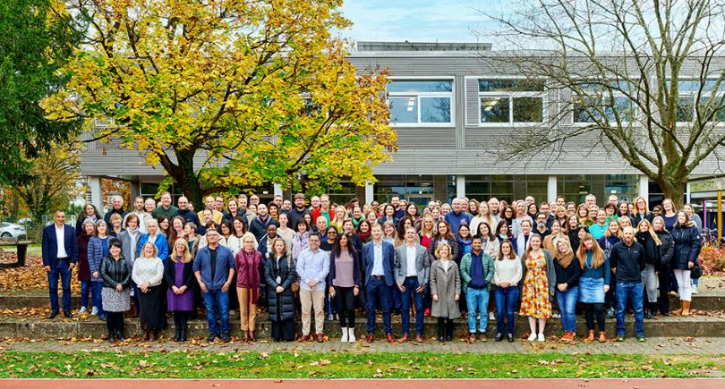
Nursery and Primary Cycle (ESK)
What is so SPECIAL about ESK?
Our whole ESK TEAM takes care of the children
Highly qualified teaching staff
Nurse
Librarian
School Psychologist
Security Staff
Care Team
Support Coordinator

Slide 8

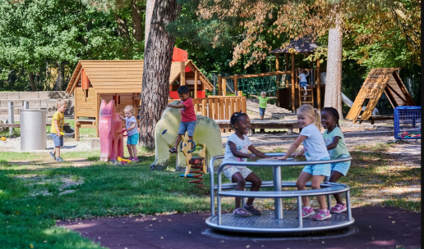
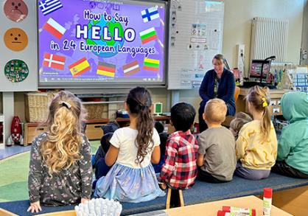
Nursery - Kindergarten
What is so SPECIAL about ESK?
2 years of Kindergarten
Children learn through a
play based curriculum
Activities also in mixed groups
across language sections
Transition programme
from Kindergarten to Class 1 in Primary
Educational Support programme

Slide 9
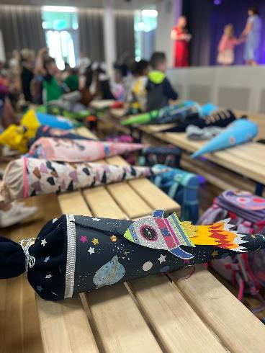
SUBJECTS PRIMARY SCHOOL
1-2 Class 3-4-5 Class
Language I (mother tongue) 8h 6h30
Language II (first language) 2h30 3h45
Mathematics 4h 5h15
Discovery of the World 1h30 3h
Art, Music + Sport 5h 3h
Religion / Ethics 1h 1h30
“European hours” (From Class 3) 1h30

Slide 10
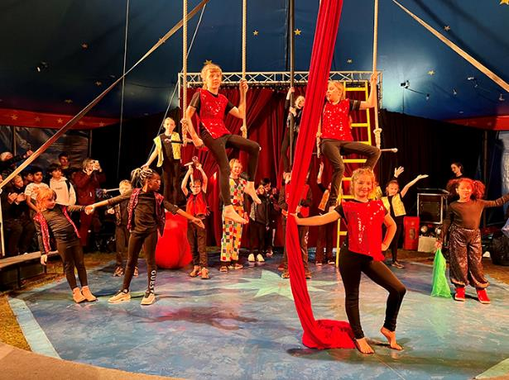
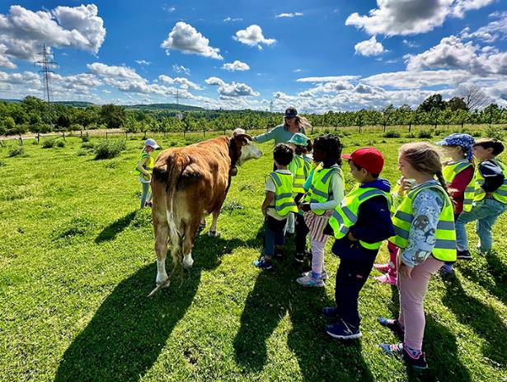
PROJECTS PRIMARY SCHOOL
Laboratory projects
Bicycle training on school premises
European Hours: Newspaper, Film making...
Project weeks
Green Week: Class trips (Primary 1-5)

Slide 11

OBERSCHULE (Gymnasium)
SECONDARY CYCLE
CYCLE SECONDAIRE
Secondary 4-5 (9.-10. Klasse)
L1, L2, L3, Mathematics, Biology, Chemistry, Physics, Geography, History, Physical Education, Rel./Ethics,
L4 (3rd FL), Economics, Latin, Ancient Greek, Art, Music, ICT
Secondary 1-3 (6.-8. Klasse)
L1 (Dominant Language),
L2 (1st Foreign Language), L3 (2nd FL)
Mathematics, Integrated Sciences, Human Sciences, Physical Education, Rel./Ethics, Art, Music, ICT
Latin, ICT (computer studies)*
Core subjects Optional subjects
Secondary 6-7 (11.- 12. Klasse)
L1, L2, Mathematics, Biology*, Geography**, History**, Philosophy**, Physical Education, Religion/Ethics
L3, L4, Chemistry, Physics, Economics, Advanced L1 & L2, Advanced Mathematics, Latin, Art, Laboratory Biology-Chemistry-Physics, Music, ICT, L5, Sociology

Slide 12
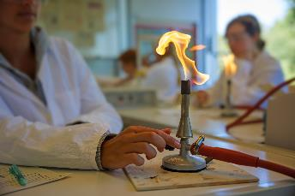
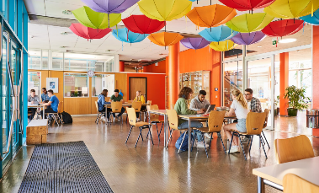
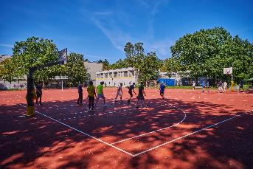
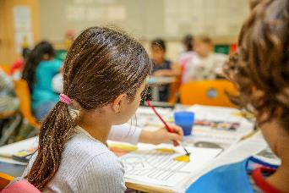
High quality of teaching
Qualified teachers, selected and evaluated with national authorities/inspectors
Mother tongue teachers for languages
Up to date equipped teaching rooms : science labs, IT, sports halls, music, art
Differentiated teaching and educational support based on individual needs
Continuous oral and written assessment of pupils
Educational advisers to support pedagogical development of the pupils

Slide 13


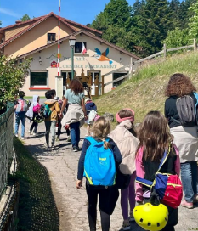
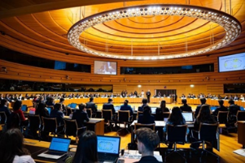
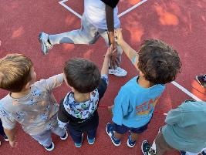
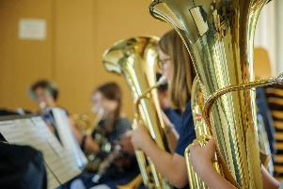
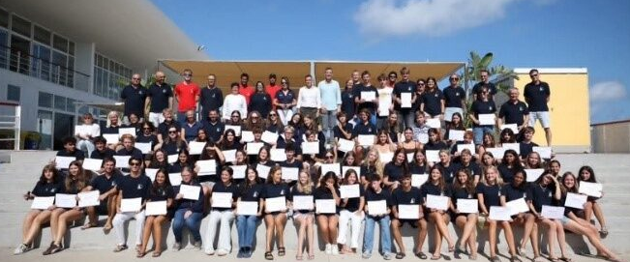
Projects to complement teaching and
strengthen pupils' competences
Eurosport
Model European Council (MEC)
Philo days
European School Science Symposium
Fames
Projects in collaboration with JRC
Challenge programme
BYOD (bring your own device)
Pro Familia programme
Pupils’ exchange programmes
School trips and excursions

Slide 14
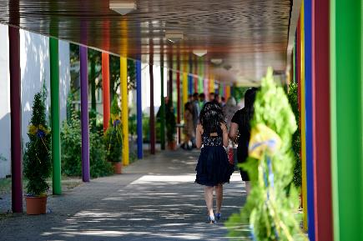
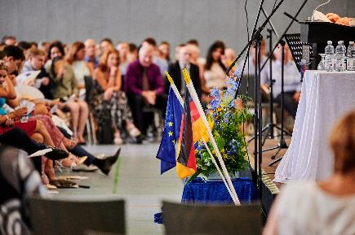
European Baccalaureate
Flexible choice of subjects corresponding to pupil’s
abilities
interests
competences
High passing rates: between 95 and 100% of success every year
Fully recognized in all the countries of the European Union, as well as in a number of others e.g. Switzerland, USA, Canada.
European Baccalaureate certificate holders enjoy the same rights and benefits as other holders of secondary school-leaving certificates in their countries

Slide 15

PARENTS’ ASSOCIATION OF THE ESK
WELCOME
https://www.esk-eltern.de
1

Slide 16
WHO WE ARE
  The Parents’ Association – an established role within the European School system
  Historically, the European Schools were founded on the initiative of parents.
  Parents play an officially recognised role within the European Schools.
  This role is anchored in the Statute of the European Schools.
  Parents are an active part of the school structure, not merely accompanying stakeholders.
https://www.esk-eltern.de
2

Slide 17

KA PA & OUR MISSION
  Parents’ Association (PA) of the ES Karlsruhe
  An association of parents for parents
  A registered association, organised on a voluntary basis
  A link between parents and the school
  What is our mission?
  Represent parents’ interests
  Support school development in a constructive manner
  Strengthen the school community
https://www.esk-eltern.de
2

Slide 18
WHAT WE DO IN PRACTICE
  Our areas of action
  Everyday school life & framework conditions
  Projects & funding
  i.e. Organisation and support of Canteen / Transport / Afterschool Activities
  i.e. Financial support for school-related projects...
  Events & community
  Communication & networking
  i.e. Organisation of PA Café, social events, Summer Fest, Presence at Open Day, school enrolment and school events...
  i.e. Exchange between parents, class representatives and the school, Participation in committees and conferences (Primary & Secondary)...
https://www.esk-eltern.de
3

Slide 19

BEHIND THE SCENES
How we work:
  Voluntary, yet structured
  Working groups instead of individual efforts
  Close coordination with the school and governing bodies
  Focus on solutions, not on volume
  PAC: 17 members plus active supporters
https://www.esk-eltern.de
7

Slide 20
GETTING INVOLVED IS WORTH IT
Why engagement matters
  Shape and contribute instead of merely reacting
  Create impact for the entire school community
  Flexible involvement – no permanent role required
This school thrives on the commitment of its parents
https://www.esk-eltern.de
7

Slide 21
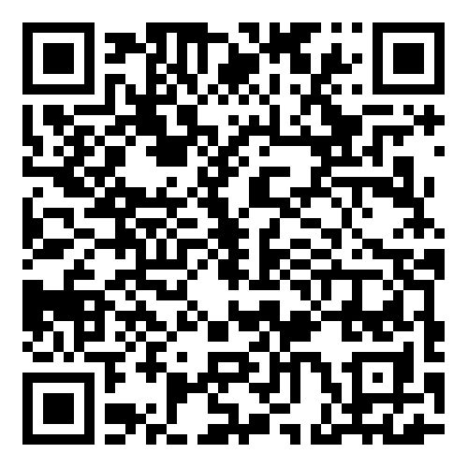
ADMISSION CRITERIA - Age requirement
The purpose of the European Schools is to provide nursery, primary and secondary age pupils with a multilingual and multicultural education.
Pupils are admitted to the nursery school at the beginning of the school year in September of the calendar year in which the child reaches four years of age.
Pupils are admitted to primary year 1 at the beginning of the school year in September of the calendar year in which the child reaches six years of age.
In principle, no child may be admitted to the school if he/she is two years (three years for secondary years 4-6) older than the normal age resulting from application of the above provisions to his/her particular case.
Please note that the European Schools do not keep long-term waiting lists.
Applications can be submitted 8-9 months before the child starts school.
Enrolment for the 2026-2027 school year is possible from January 2026.
The registration procedure is available on the website:

Slide 22
ADMISSION CRITERIA - Basic Principles
The European Schools were set up to provide education primarily for the children of employees of EU Institutions. Here in Karlsruhe, there is the EU Institute JRC Joint Research Centre, and in Strasbourg the European Parliament.
Pupils from other backgrounds can apply and are admitted on a case-by-case basis.

Slide 23
Breakdown of pupils into three categories
Admission Requirements
According to their situation, pupils can be admitted as Category I, II or III. The eligibility rules vary depending on the Category.
Applications are processed in the following order of priority:
Priority in admissions is given to children from Category I, followed by Category II and finally Category III. Consideration is also given to children who already have a sibling at the school.
Category I: Eligible pupils - Officials and other servants of the European Institutions
Category II: Pupils covered by Financial Agreement: Financial agreement with Companies and Employers or Individual financial agreement (Private families can also sign an individual financial agreement of category 2).
Category III: Admission possible only in case of remaining places, after admission of cat I and II applications: Decisions will be made according to the order of admission priority, after all children in categories I and 2 have been admitted.
Decisions regarding admission to Cat III for the 2026-2027 school year will be made in Spring 2026.
The fees for all the European Schools are available on the European Schools website www.eursc.eu

Slide 24

Enrolment
For more information about the European School Karlsruhe and application process, please feel free to contact us.
We look forward to introducing you to our school and its special features and answering any questions you may have.
Katharina Lins
Admission Nursery - Kindergarten
Stefania Bartholdy
Admission Primary and Secondary School

Slide 25

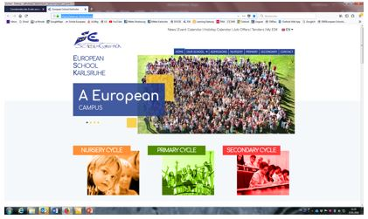
Thank you for your attention !
28.02.2026: Open Day at the ESK
Europäische Schule Karlsruhe
  Albert Schweitzer Str. 1
  D-76139 Karlsruhe
  Tel: 0049 (0)7 21 6 80 09-0
  www.es-karlsruhe.eu

